Slide 1
CSP571 Data Preparation and Analysis
Lecture 4. Error estimation. Classification
Oleksandr Narykov
onarykov@iit.edu

Slide 2
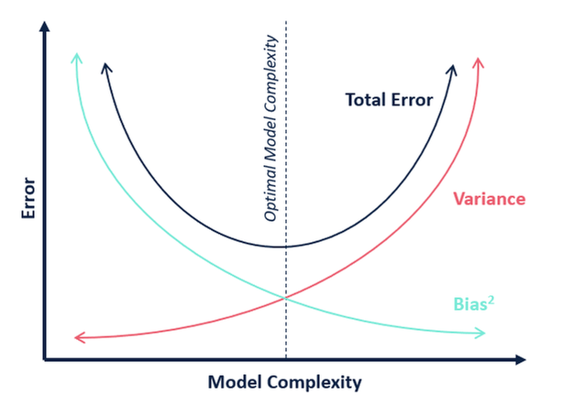
Bias / Variance Tradeoff

Slide 3
Revisiting Probability Theory

Slide 4
Motivation
Learning
Statistics, expectations, etc.
E.g., decision trees, naïve Bayes, logistic regression, …
Evaluation
Statistics, expectations, variance, etc.
E.g., expected error using a sample
2

Slide 5
Some Questions
Given a domain with n variables, 𝑋₁, 𝑋₂, … , 𝑋_{𝑛}, each of which has
𝑣₁, 𝑣₂, … , 𝑣_{𝑛} possible values, what is the size of the instance space?
Given a sample dataset and a hypothesis h, calculate the mean,
variance, and 95% confidence interval for the error rate of h
Type I error has cost 𝑐₁ and type II error has cost 𝑐₂. Correct decisions have no cost. The probability of the object belonging to Positive class is p. Should it be classified as Positive or Negative?
Given P(Symptoms|Diseases), P(Diseases) and P(Symptoms), calculate P(Diseases|Symptoms)
Given a probability distribution 𝑝₁, 𝑝₂, … , 𝑝_{𝑘}, calculate its entropy
3

Slide 6
Random Variables
Pick variables of interest
Medical diagnosis
Age, gender, weight, temperature, …
Loan application
Income, wealth, payment history, …
Every variable has a domain
Binary (True/False)
Categorical
Real-valued
Possible world
An assignment to all variables of interest
4

Slide 7
Probability Model
A probability model associates a numerical probability P(w) with each possible world w
P(w) sums to 1 over all possible worlds
An event is the set of possible worlds where a given predicate is true
Roll two dice
The possible worlds are (1,1), (1,2), …, (6,6); 36 possible worlds
Predicate = two dice sum to 10
Event = {(4,6), (5,5), (6,4)}
Toothache and cavity
Four possible worlds: (𝑡, 𝑐), (𝑡, ~𝑐), (~𝑡, 𝑐), (~𝑡, ~𝑐)
Some worlds are more likely than others
Predicate can be anything about these variables: 𝑡 ∧ 𝑐, 𝑡, 𝑡 ∨ ~𝑐,
5

Slide 8
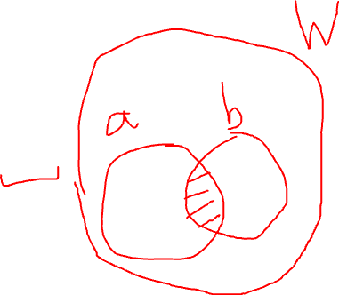
Axioms of Probability
The probability P(a) of a proposition a is a real number between 0 and 1
P(true) = 1, P(false) = 0
P(a ∨ b) = P(a) + P(b) – P(a ∧ b)
6

Slide 9
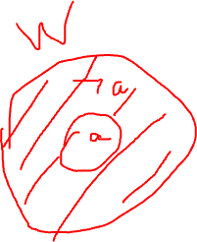
P(¬a)
P(a ∨ ¬a) = P(a) + P(¬a) – P (a ∧ ¬a)
P(true) = P(a) + P(¬a) – P(false)
1 = P(a) + P(¬a) – 0
P(¬a) = 1 – P(a)
Intuitive explanation:
The probability of all possible worlds is 1
Either a or ¬a holds in one world
The worlds that a holds and the worlds that ¬a holds
are mutually exclusive and exhaustive
7

Slide 10
Random Variables – Notation
Capital: X: variable
Lowercase: x: a particular value of X
Val(X): the set of values X can take
Bold Capital: X: a set of variables
Bold lowercase: x: an assignment to all variables in X
P(X=x) will be shortened as P(x)
P(X=x ∩ Y=y) will be shortened as P(x,y)
8

Slide 11
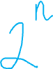
Joint Distribution
We have n random variables, X₁, X₂, …, X_{n}
We are interested in the probability of a possible world, where
X₁=low, X₂=red, …, X_{n}=circle
P(X₁, X₂, …, X_{n}) associates a probability for each possible world ≡
the joint distribution
How many entries are there, if we assume the variables are all
binary?
9
Notes:
2^n

Slide 12
Toothache example
Feeling | X-Ray | P(F,X)
toothache | cavity | 0.15
toothache | ¬cavity | 0.10
¬toothache | cavity | 0.05
¬toothache | ¬cavity | 0.70
10

Slide 13
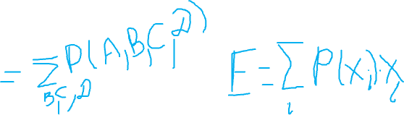
Marginalization
Given a distribution over n variables, you can calculate the distribution over any subset of the variables by summing out the irrelevant ones
For example
Given P(A, B, C, D)
Calculate
P(A)
P(A, C)
… (any subset)
11
Notes:
Sum by B,C,D
Sum by B,D

Slide 14
Back to Bias-Variance Tradeoff

Slide 15
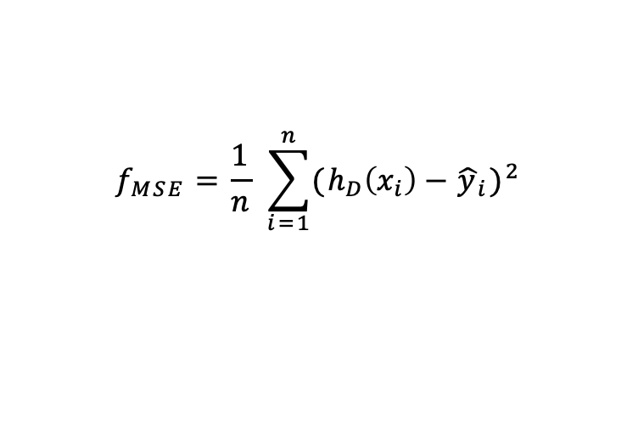
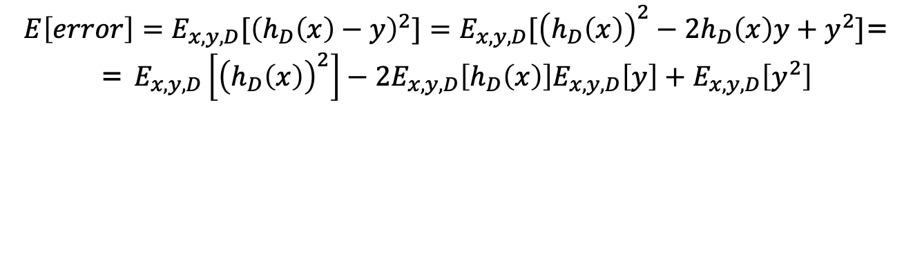
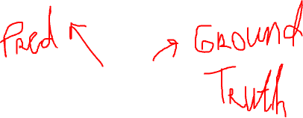
Bias-Variance Trade-off Derivation
$$f_{MSE}=\frac{1}{n} \sum_{i=1}^{n}{{(h_{D}\left(x_{i}\right)−{\hat{y}}_{i})}^{2}}$$
$E\left[error\right]=E_{x,y,D}[{\left(h_{D}\left(x\right)−y\right)}^{2}]=E_{x,y,D}[{\left(h_{D}\left(x\right)\right)}^{2}−2h_{D}\left(x\right)y+y^{2}]$=
= $E_{x,y,D}\left[{\left(h_{D}\left(x\right)\right)}^{2}\right]−2E_{x,y,D}\left[h_{D}\left(x\right)\right]E_{x,y,D}\left[y\right]+E_{x,y,D}\left[y^{2}\right]$
5

Slide 16
Bias-Variance Trade-off Derivation
5

Slide 17
Bias-Variance Trade-off Derivation
5

Slide 18
Bias-Variance Trade-off Derivation
5

Slide 19
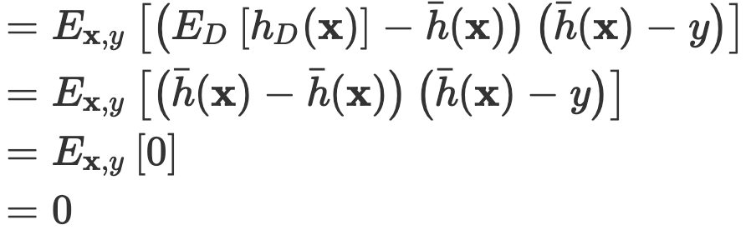
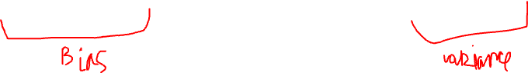
Bias-Variance Trade-off Derivation
5

Slide 20
Bias vs Variance
High bias
More assumptions
E.g., naïve Bayes, linear regression, large priors
Simpler models
E.g., linear models, small decision trees, small neural
networks, high regularization, …
High variance
Fewer assumptions
E.g., logistic regression versus naïve Bayes, MLE vs Bayesian, small priors
More complex models
E.g., polynomial regression versus linear regression, bigger
neural nets versus smaller ones, less regularization
Small data
7

Slide 21

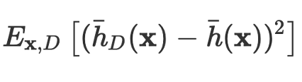
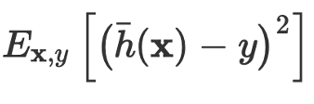
Bias vs Variance
7
http://scott.fortmann-roe.com/docs/BiasVariance.html

Slide 22
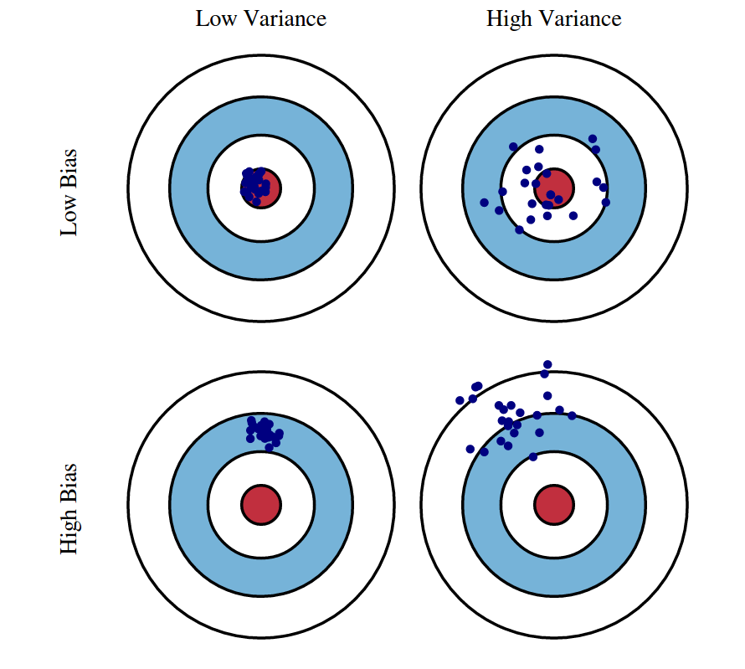
Bias vs Variance
7
http://scott.fortmann-roe.com/docs/BiasVariance.html

Slide 23
Classification

Slide 24
Classification Problem
Given a labeled dataset 𝒟 = {⟨𝑥_{𝑖}, 𝑦_{𝑖}⟩}, where 𝑥_{𝑖} is the input and 𝑦_{𝑖} is the discrete output
Train a classifier 𝑓: 𝒳 → 𝒴 using 𝒟
The purpose of 𝑓 is to perform “well” on unseen data
How do we define “well”?
2

Slide 25
Accuracy
The simplest measure is “is the prediction correct?”
Examples
Given an email, the model predicts it’s spam. Is it
correct?
Given a patient, the model predicts the patient is suffering from Heart disease. Is it correct?
Given a loan application, the model recommends reject. Is the recommendation correct?
Given a dataset, accuracy is the percentage of objects the
model’s predictions are correct
3

Slide 26
True Error
Given ℎ(𝑥), we are interested in
∑_{𝑥~𝓧} 𝑃 𝑥 I ℎ(𝑥) ≠ 𝑐(𝑥) , where
𝓧 is the space of all possible instances
𝑃 𝑥 is the probability of seeing instance 𝑥
I ℎ(𝑥) ≠ 𝑐(𝑥)
0 otherwise
Problems
is 1 if the prediction by h is incorrect;
𝓧 is super large; exponential in the size of the
domains of the variables
We do not know 𝑃 𝑥
17

Slide 27
Sampling
When space is large, sample from 𝑃 𝑥
When 𝑃 𝑥 is not known, or sampling from 𝑃 𝑥
is not possible, collect a “representative” sample
Let 𝒟~𝑃 𝑥 be a representative sample
For example, true mean versus sample mean
∑_{𝑥~𝓧} 𝑃 𝑥 𝑥
1
∑ 𝑥

𝑥∈𝒟
|𝒟|
How do we know how close the true mean and the sample mean are?
19

Slide 28
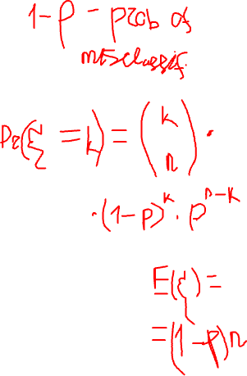
Sample Error
Let 𝒟~𝑃 𝑥 be a representative dataset
Sample error
1

|𝒟|
σ_{𝑥∈𝒟} I ℎ(𝑥) ≠ 𝑐(𝑥)
Remember the binomial distribution
n experiments, each with p success probability
n data points, each with p true error
Sample error is based on a binomial distribution where exactly
k objects are incorrectly labeled
What is the probability that k objects are incorrectly labeled? What is the expectation? What is the variance? What is the 95% confidence interval?
Important note: h and 𝒟 must be independent; h cannot depend on 𝒟
20

Slide 29
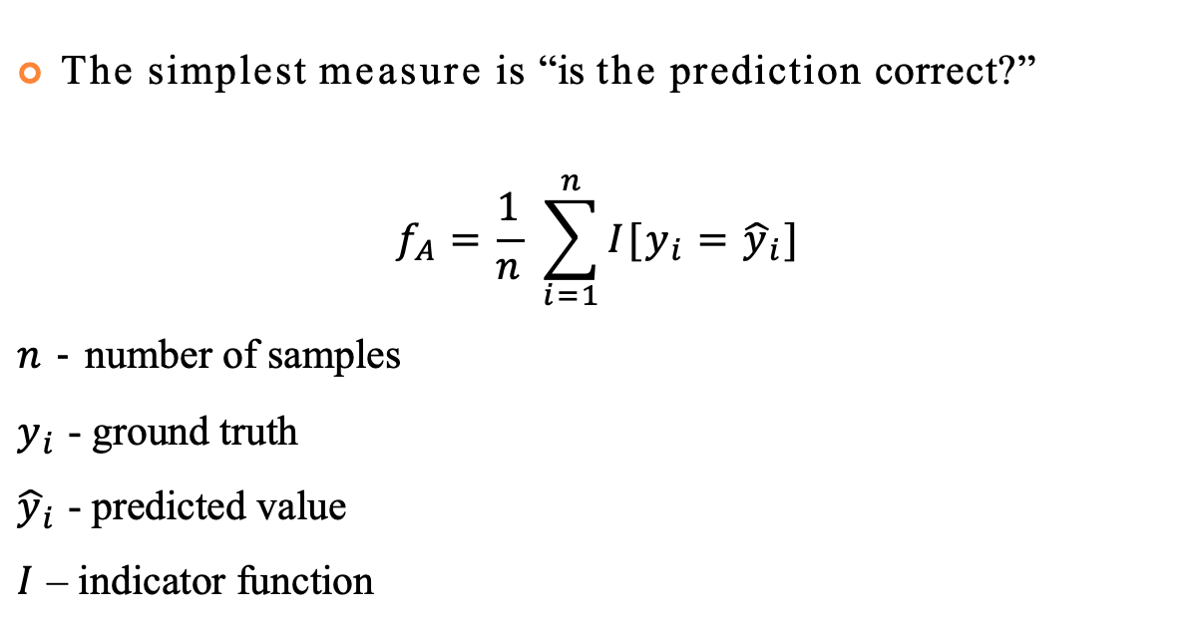
Accuracy
The simplest measure is “is the prediction correct?”
$$f_{A}=\frac{1}{n} \sum_{i=1}^{n}{I[y_{i}={\hat{y}}_{i}]}$$
$n$ - number of samples
$y_{i}$ - ground truth
${\hat{y}}_{i}$ - predicted value
$I$ – indicator function
3

Slide 30
Some Problems with Accuracy
All mistakes are considered equal; for example
Misclassifying a spam email as spam, and misclassifying an important email as spam are considered equally bad
Approving a loan application that should have been rejected, and rejecting a loan application that should have been approved are considered equally bad
95% of tested patient do not have cancer
If a class is dominant, it’s often easy to get high accuracy by simply predicting every object as the dominant class; for example
If 80% of the emails are good, a classifier that classifies every email as good will have 80% accuracy
All cases are considered equal; for example, email from your family, boss, bank, social media updates, … are all considered equally important, which might or might not be true
4

Slide 31
Types of Classification Errors
Assume a target/positive class
Spam, HasHeartDisease, Approve, etc.
This step is important; positive does not mean “good”; positive mean
the concept of interest and you decide which class is positive
For example, positive covid test does not mean “good” news
False positive
Falsely classifying an object as positive
E.g., classifying a ham email as spam, diagnosing a healthy patient as having heart disease, approving a loan that should have been rejected, and so on
Also called Type I error
False negative
Falsely classifying an object as negative
E.g., classifying a spam email as spam, claiming that a heart-disease patient
is healthy, rejecting a loan that should have been approved, and so on
Also called Type II error
5

Slide 32
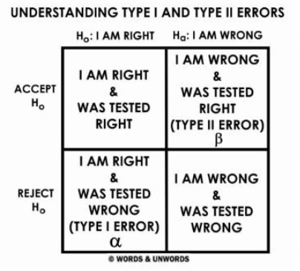
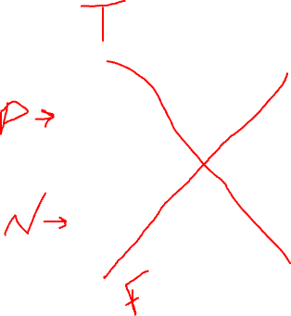
Types of Classification Errors
Assume a target/positive class
Spam, HasHeartDisease, Approve, etc.
This step is important; positive does not mean “good”; positive mean
the concept of interest and you decide which class is positive
For example, positive covid test does not mean “good” news
False positive
Falsely classifying an object as positive
E.g., classifying a ham email as spam, diagnosing a healthy patient as having heart disease, approving a loan that should have been rejected, and so on
Also called Type I error
False negative
Falsely classifying an object as negative
E.g., classifying a spam email as spam, claiming that a heart-disease patient
is healthy, rejecting a loan that should have been approved, and so on
Also called Type II error
5

Slide 33
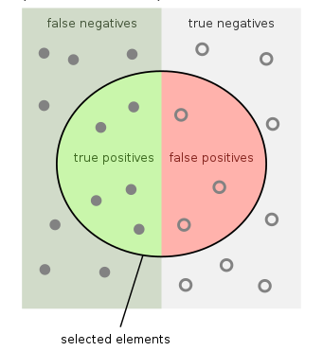
Confusion Matrix
 |  | Predicted Class
 |  | Positive | Negative
Actual Class | Positive | True Positive | False Negative
 | Negative | False Positive | True Negative
6

Slide 34
Accuracy
 |  | Predicted Class
 |  | Positive | Negative
Actual Class | Positive | True Positive | False Negative
 | Negative | False Positive | True Negative
𝑁𝑢𝑚 𝐶𝑜𝑟𝑟𝑒𝑐𝑡
𝑇𝑃 + 𝑇𝑁
𝐴𝑐𝑐𝑢𝑟𝑎𝑐𝑦 =
=
𝐷𝑎𝑡𝑎 𝑆𝑖𝑧𝑒
𝑇𝑃 + 𝑇𝑁 + 𝐹𝑃 + 𝐹𝑁
7

Slide 35
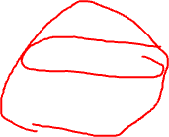
Precision
 |  | Predicted Class
 |  | Positive | Negative
Actual Class | Positive | True Positive | False Negative
 | Negative | False Positive | True Negative
𝑇𝑟𝑢𝑒 𝑃𝑜𝑠𝑖𝑡𝑖𝑣𝑒
𝑇𝑃
𝑃𝑟𝑒𝑐𝑖𝑠𝑖𝑜𝑛 =
=
𝑃𝑟𝑒𝑑𝑖𝑐𝑡𝑒𝑑 𝑃𝑜𝑠𝑖𝑡𝑖𝑣𝑒
𝑇𝑃 + 𝐹𝑃
8

Slide 36

Recall – True Positive Rate – Sensitivity
 |  | Predicted Class
 |  | Positive | Negative
Actual Class | Positive | True Positive | False Negative
 | Negative | False Positive | True Negative
𝑇𝑟𝑢𝑒 𝑃𝑜𝑠𝑖𝑡𝑖𝑣𝑒
𝑇𝑃
𝑇𝑃𝑅 = 𝑅𝑒𝑐𝑎𝑙𝑙 =
=
𝐴𝑐𝑡𝑢𝑎𝑙 𝑃𝑜𝑠𝑖𝑡𝑖𝑣𝑒
𝑇𝑃 + 𝐹𝑁
9

Slide 37

True Negative Rate – Specificity
 |  | Predicted Class
 |  | Positive | Negative
Actual Class | Positive | True Positive | False Negative
 | Negative | False Positive | True Negative
𝑇𝑟𝑢𝑒 𝑁𝑒𝑔𝑎𝑡𝑖𝑣𝑒
𝑇𝑁
𝑇𝑁𝑅 = 𝑆𝑝𝑒𝑐𝑖𝑓𝑖𝑐𝑖𝑡𝑦 =
=
𝐴𝑐𝑡𝑢𝑎𝑙 𝑁𝑒𝑔𝑎𝑡𝑖𝑣𝑒
𝑇𝑁 + 𝐹𝑃
10

Slide 38

False Positive Rate – Fall-out
 |  | Predicted Class
 |  | Positive | Negative
Actual Class | Positive | True Positive | False Negative
 | Negative | False Positive | True Negative
𝐹𝑎𝑙𝑠𝑒 𝑃𝑜𝑠𝑖𝑡𝑖𝑣𝑒
𝐹𝑃
𝐹𝑃𝑅 = 𝐹𝑎𝑙𝑙𝑂𝑢𝑡 =
=
𝐴𝑐𝑡𝑢𝑎𝑙 𝑁𝑒𝑔𝑎𝑡𝑖𝑣𝑒
𝑇𝑁 + 𝐹𝑃
11

Slide 39

False Negative Rate – Miss Rate
 |  | Predicted Class
 |  | Positive | Negative
Actual Class | Positive | True Positive | False Negative
 | Negative | False Positive | True Negative
𝐹𝑎𝑙𝑠𝑒 𝑁𝑒𝑔𝑎𝑡𝑖𝑣𝑒
𝐹𝑁
𝐹𝑁𝑅 = 𝑀𝑖𝑠𝑠 𝑅𝑎𝑡𝑒 =
=
𝐴𝑐𝑡𝑢𝑎𝑙 𝑃𝑜𝑠𝑖𝑡𝑖𝑣𝑒
𝑇𝑃 + 𝐹𝑁
12

Slide 40
F1
 |  | Predicted Class
 |  | Positive | Negative
Actual Class | Positive | True Positive | False Negative
 | Negative | False Positive | True Negative
2 ∗ 𝑃𝑟𝑒𝑐𝑖𝑠𝑖𝑜𝑛 ∗ 𝑅𝑒𝑐𝑎𝑙𝑙
𝐹1 =
𝑃𝑟𝑒𝑐𝑖𝑠𝑖𝑜𝑛 + 𝑅𝑒𝑐𝑎𝑙𝑙
12

Slide 41
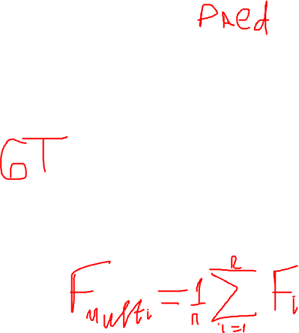
Multiclass Confusion Matrix
 | C1 | C2 | C3 | C4 | C5
C1 | TN | TN | FP | TN | TN
C2 | TN | TN | FP | TN | TN
C3 | FN | FN | TP | FN | FN
C4 | TN | TN | FP | TN | TN
C5 | TN | TN | FP | TN | TN
12

Slide 42
Other Measures based on Confusion Matrix
False discovery rate = FP/PP
False omission rate = FN/PN
Negative predictive value = TN/PN
Positive likelihood ratio = TPR/FPR
Negative likelihood ratio = FNR/TNR
Diagnostic odd ratio = PLR / NLR
…
14

Slide 43
Cost-Sensitive Classification
Given a probabilistic output for an object, say
𝑝, 1 − 𝑝 , how do we decide which class to assign to this object?
The simplest approach is check whether 𝑝 > 0.5
and make a decision accordingly
This assumes each mistakes (False Positives and False Negatives) are equally costly
25

Slide 44
Equal Misclassification Costs?
Which one is worse for you:
Delivering a spam email into your Inbox (False Negative), or
Delivering a legitimate email into your Spam folder (False Positive)?
If one is worse than the other, then, should we use 0.5 as the decision threshold or should we adjust it to your preference?
26

Slide 45
Cost Matrix
 |  | Predicted Class
 |  | Positive | Negative
Actual Class | Positive | 0 | a
 | Negative | b | 0
Given a probability distribution of 𝑝, 1 − 𝑝 for
𝑃𝑜𝑠𝑖𝑡𝑖𝑣𝑒, 𝑁𝑒𝑔𝑎𝑡𝑖𝑣𝑒 respectively, and given the above cost matrix, under what conditions (in terms of 𝑎, 𝑏, and 𝑝) would you classify an object as 𝑃𝑜𝑠𝑖𝑡𝑖𝑣𝑒?
27

Slide 46
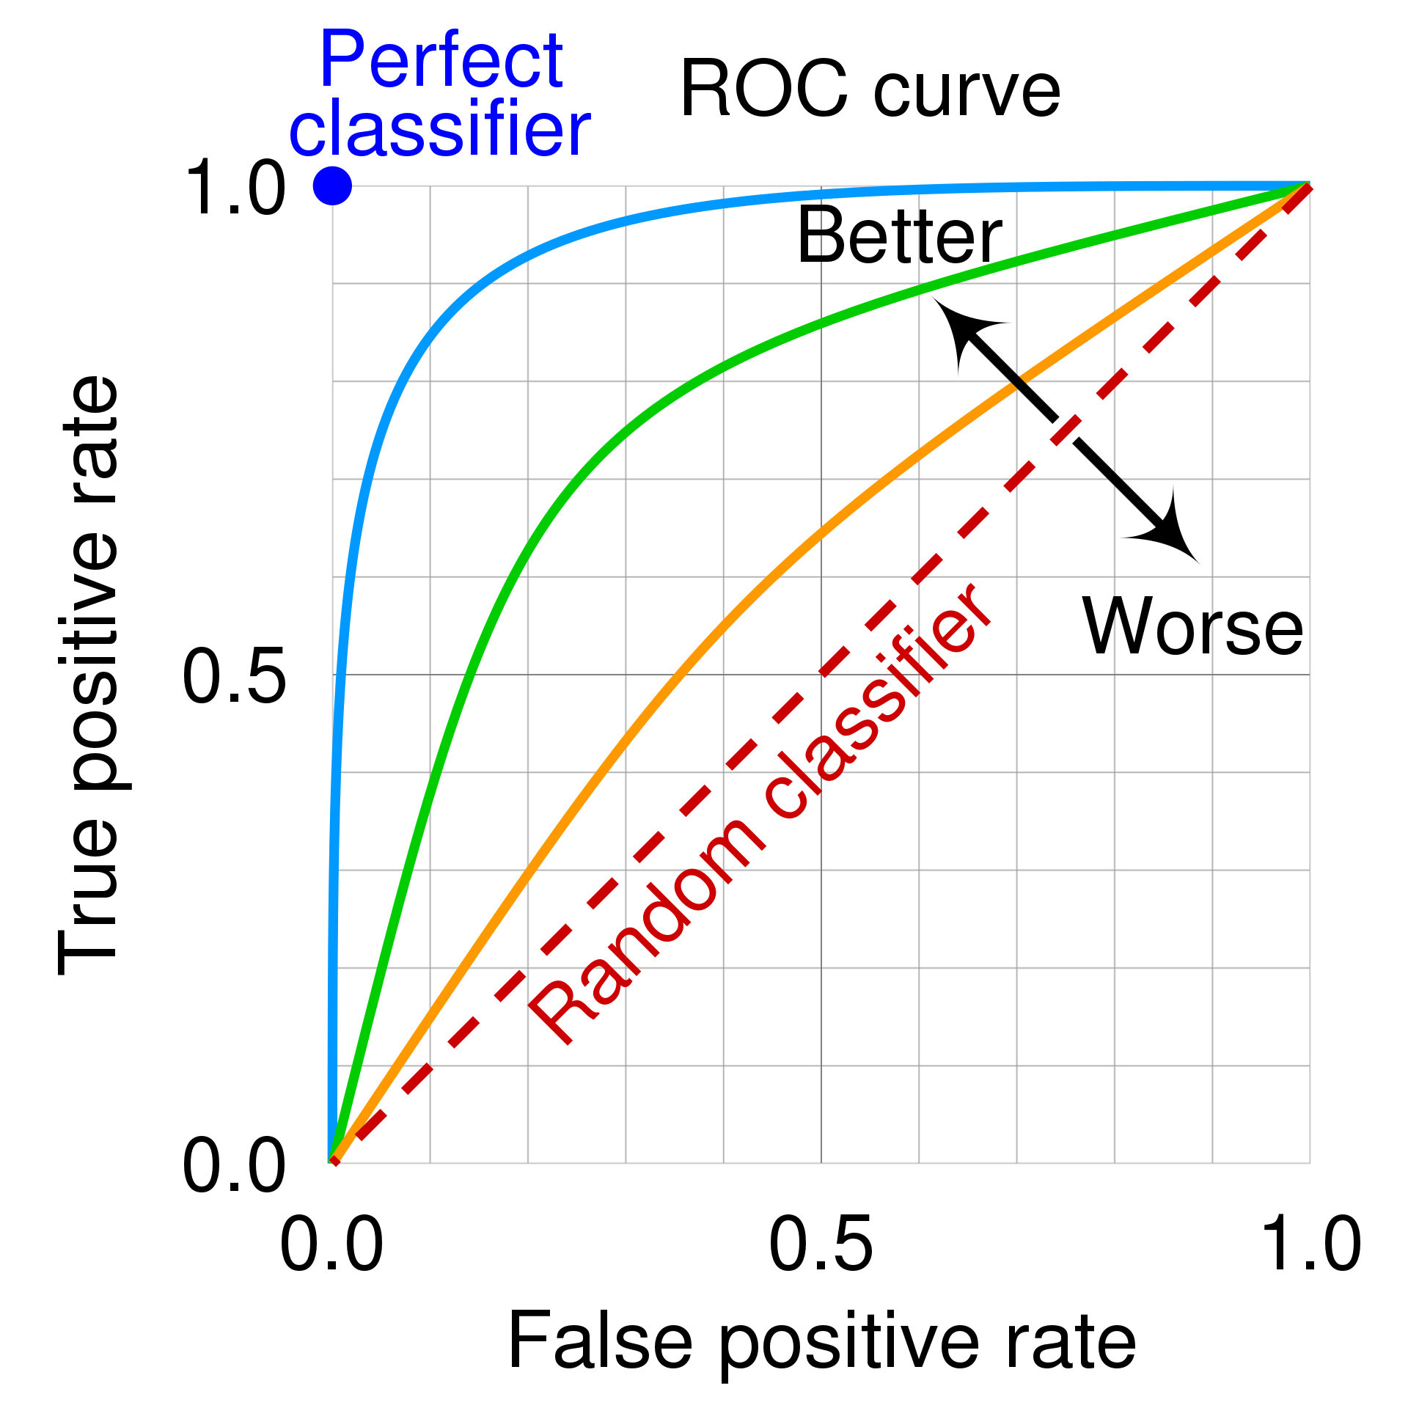

Area Under the Curve (AUC)
Area Under the Curve
What curve? ROC Curve
Receiving Operating Characteristic
The X axis is FPR
The Y axis is TPR
The curve is plotted by varying the “decision” threshold
15

Slide 47
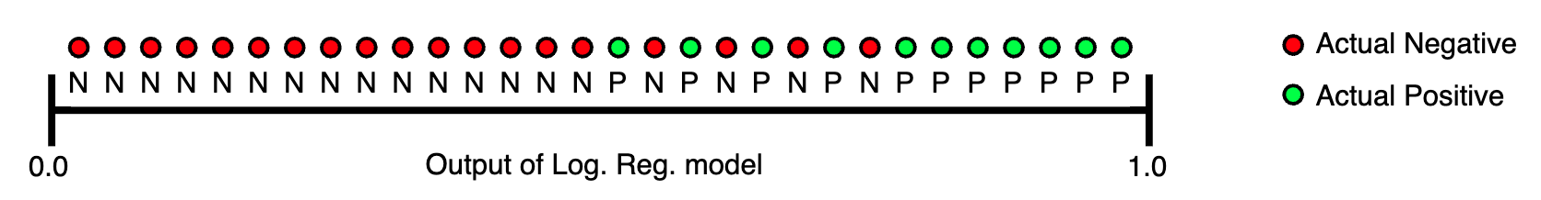
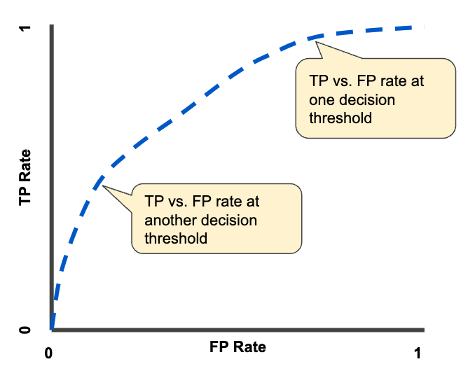
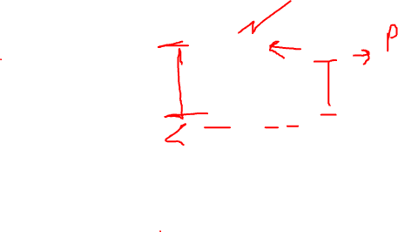
AUC Example
16

Slide 48
Logistic Regression

Slide 49
Logistic Regression
Learns 𝑃(𝑌|𝑿) directly, without going through
𝑃(𝑿|𝑌) and 𝑃(𝑌)
Assumes 𝑃(𝑌|𝑿) follows the logistic function
1
𝑃 𝑌 = 𝑓𝑎𝑙𝑠𝑒
𝑋₁, 𝑋₂, ⋯ , 𝑋_{𝑛}) =
𝑛
1 + 𝑒
𝑤 +∑
𝑤_{𝑖}𝑋_{𝑖}
0
𝑖=1
𝑒
𝑤 + ∑
𝑛
𝑖=1
𝑤_{𝑖}𝑋_{𝑖}
𝑃 𝑌 = 𝑡𝑟𝑢𝑒
𝑋₁, 𝑋₂, ⋯ , 𝑋_{𝑛}) =
0
1 + 𝑒
𝑤 + ∑
𝑛
𝑤_{𝑖}𝑋_{𝑖}
0
𝑖=1
Learning: estimate the weights 𝑤₀, 𝑤₁, … , 𝑤_{𝑛}

Slide 50
Logistic Regression

Slide 51
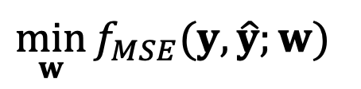
Optimization Problem
$$\min_{w}{f_{MSE}(y,\hat{y};w)}$$
10

Slide 52
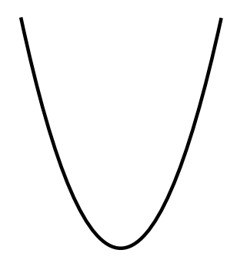
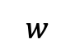
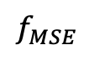
Optimization Problem
$$\min_{w}{f_{MSE}(y,\hat{y};w)}$$
Simple 1d Case – Convex Function
$$f_{MSE}$$
f
10
$$w$$

Slide 53
Convexity
Informally: bowl-shaped
f
10
Notes:
Inverse is concave

Slide 54
Convexity
Informally: bowl-shaped
f
What property ensures the existence of only one local minimum?
10

Slide 55
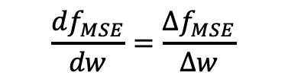
Convexity
Informally: bowl-shaped
f
$$\frac{df_{MSE}}{dw}=\frac{∆f_{MSE}}{∆w}$$
What property ensures the existence of only one local minimum?
From left to right, the slope of function never decreases
Derivative of the slope is always non-negative
10

Slide 56
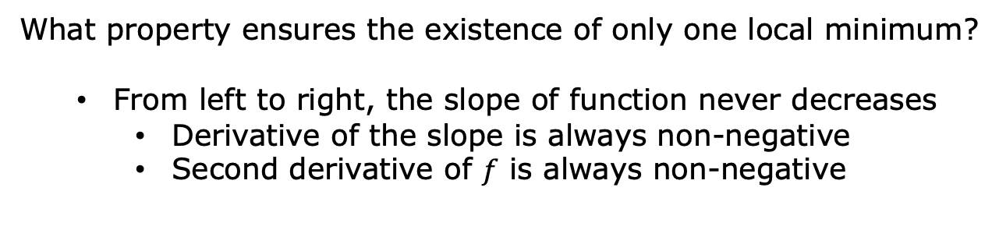
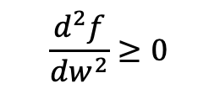

Convexity
Informally: bowl-shaped
f
$$\frac{df}{dw}=\frac{∆f}{∆w}$$
$$\frac{d^{2}f}{dw^{2}}≥0$$
What property ensures the existence of only one local minimum?
From left to right, the slope of function never decreases
Derivative of the slope is always non-negative
Second derivative of $f$ is always non-negative
10

Slide 57
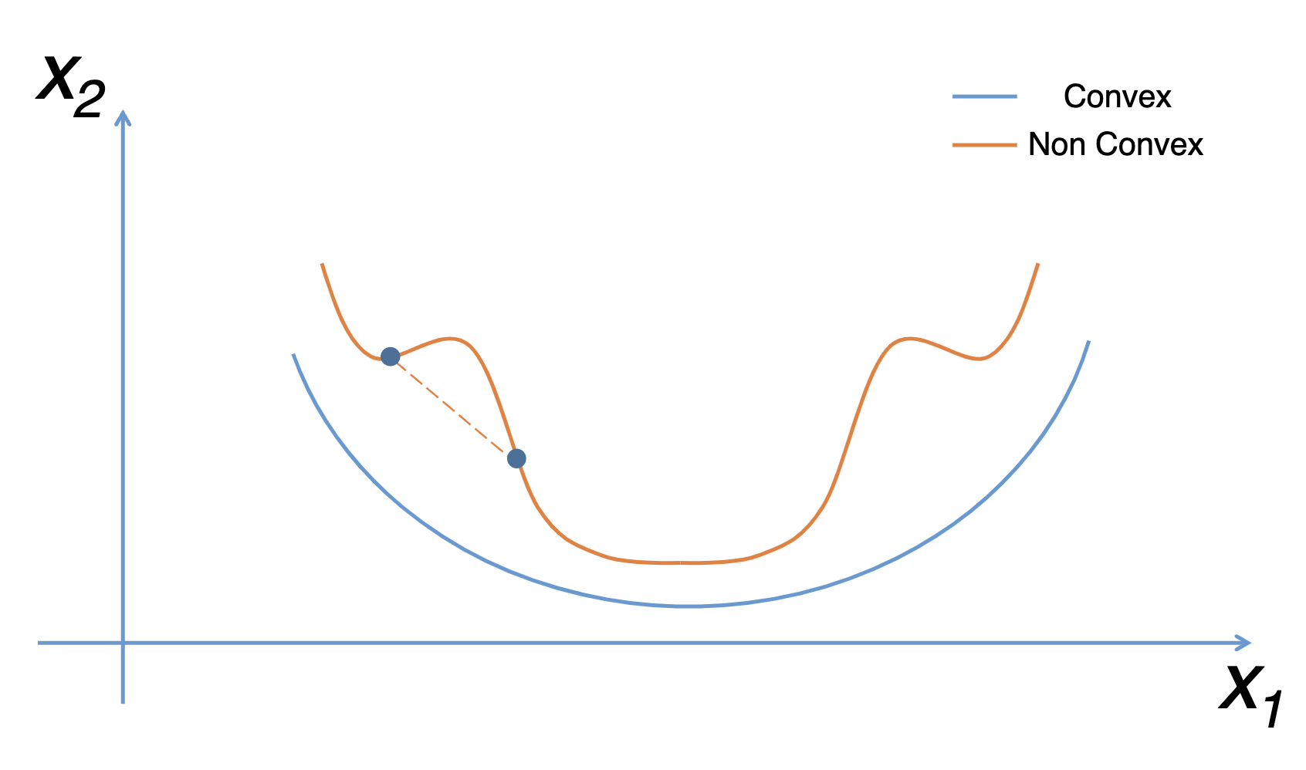
Convexity
https://fmin.xyz/docs/theory/Convex_function/
What property ensures the existence of only one local minimum?
From left to right, the slope of function never decreases
Derivative of the slope is always non-negative
Second derivative of $f$ is always non-negative
10

Slide 58
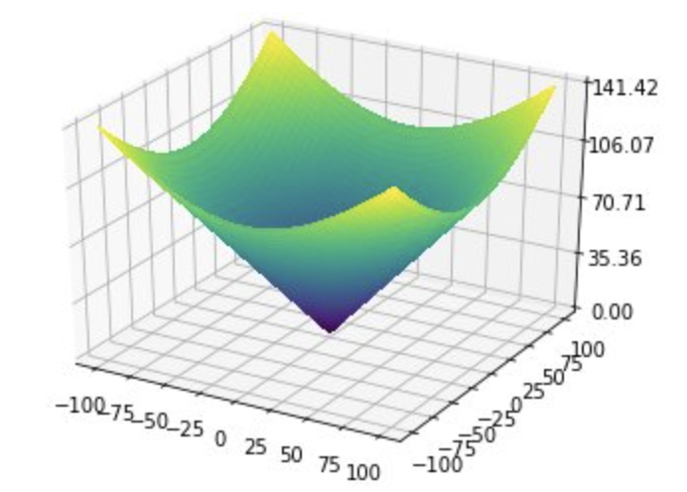
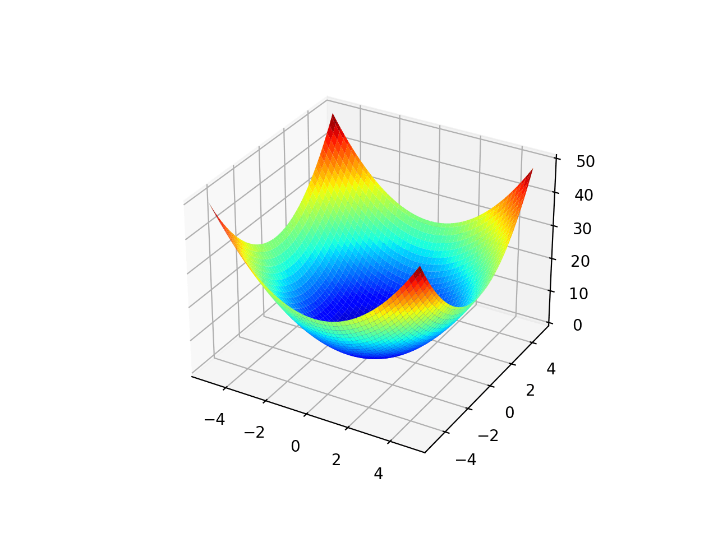
Convexity in Higher Dimensions
Informally: bowl-shaped
Benhamou, Eric, et al. "BCMA-ES: A Bayesian approach to CMA-ES." arXiv preprint arXiv:1904.01401 (2019).
https://machinelearningmastery.com/wp-content/uploads/2020/09/Surface-Plot-of-Unimodal-Optimization-Function-1.png
10

Slide 59
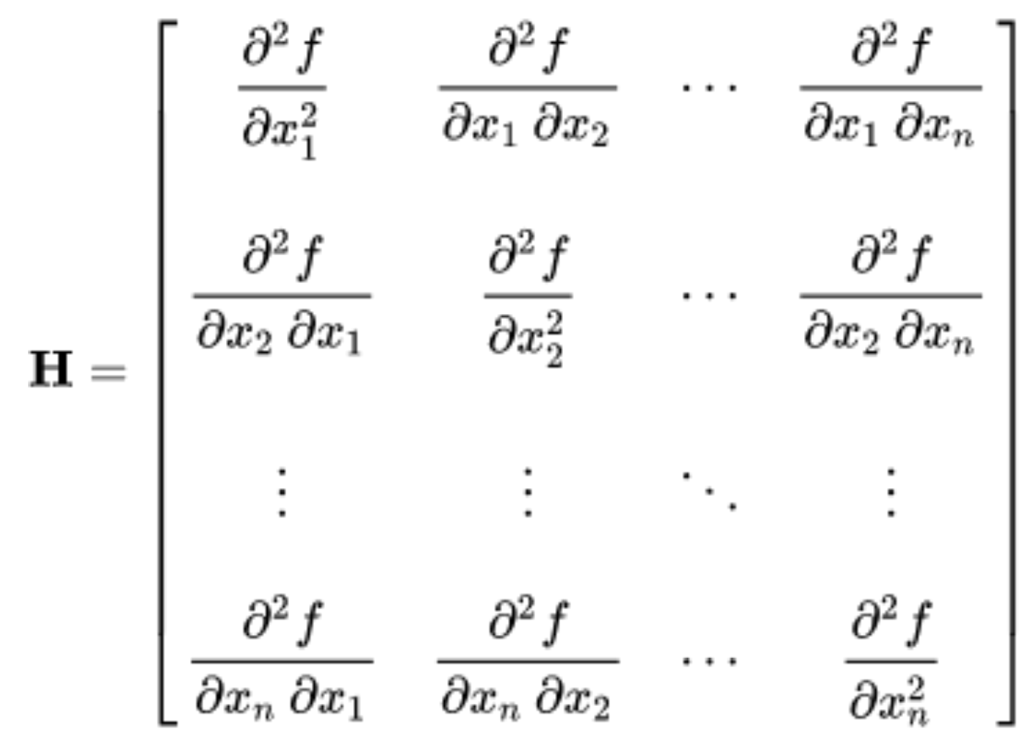
Convexity in Higher Dimensions
Informally: bowl-shaped
Formally: determined by the second-derivative matrix, Hessian
10

Slide 60
Convexity in Higher Dimensions
Informally: bowl-shaped
Formally: determined by the second-derivative matrix, Hessian
For function to be convex, Hessian matrix H should be positive
semi-definite (PSD) for every input x
10

Slide 61
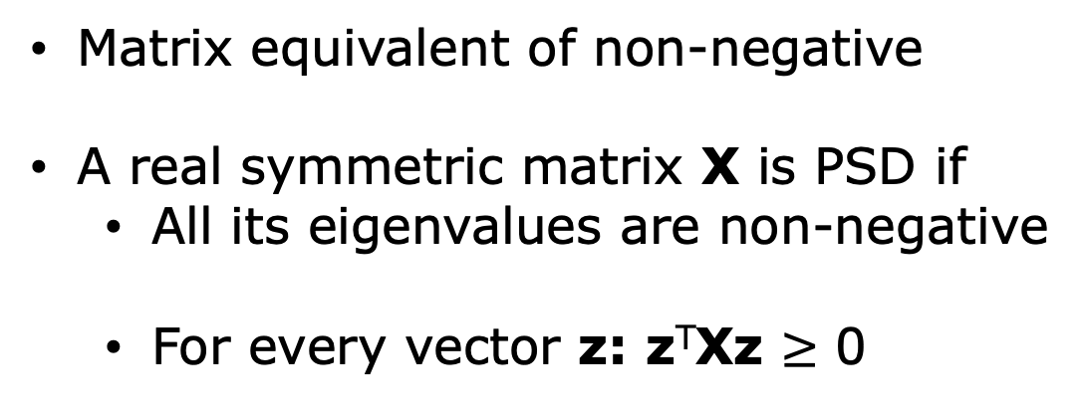
Positive Semi-Definite
Matrix equivalent of non-negative
A real symmetric matrix X is PSD if
All its eigenvalues are non-negative
For every vector z: z^{T}Xz $≥$ 0
10

Slide 62
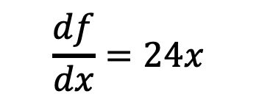
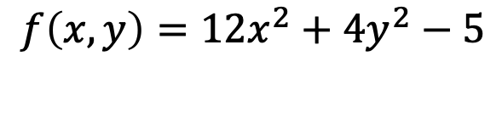
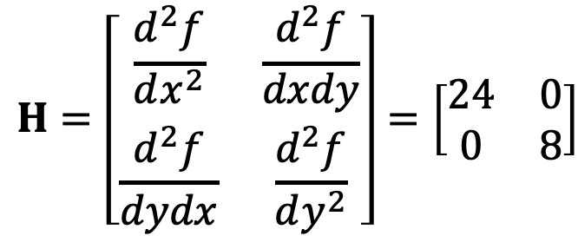
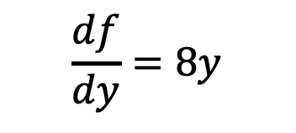
Hessian Example
$$f\left(x,y\right)=12x^{2}+4y^{2}−5$$
First derivatives:
$$\frac{df}{dx}=24x$$
$$\frac{df}{dy}=8y$$
$$H=\left[\begin{matrix}\frac{d^{2}f}{dx^{2}} & \frac{d^{2}f}{dxdy} \\ \frac{d^{2}f}{dydx} & \frac{d^{2}f}{dy^{2}}\end{matrix}\right]=\left[\begin{matrix}24 & 0 \\ 0 & 8\end{matrix}\right]$$
10

Slide 63
Hessian Example
$$f\left(x,y\right)=12x^{2}+4y^{2}−5$$
First derivatives:
$$\frac{df}{dx}=24x$$
$$\frac{df}{dy}=8y$$
$$H=\left[\begin{matrix}\frac{d^{2}f}{dx^{2}} & \frac{d^{2}f}{dxdy} \\ \frac{d^{2}f}{dydx} & \frac{d^{2}f}{dy^{2}}\end{matrix}\right]=\left[\begin{matrix}24 & 0 \\ 0 & 8\end{matrix}\right]$$
10

Slide 64
Gradient Descent

Slide 65
Optimization Problem
$$\min_{w}{f_{MSE}(y,\hat{y};w)}$$
Simple 1d Case – Convex Function
$$f_{MSE}$$
f
10
$$w$$

Slide 66
Gradient Descent
Gradient descent is a hill-climbing algorithm that
makes incremental changes to weight vector w
depending on the value of slope (i.e., gradient)
10

Slide 67
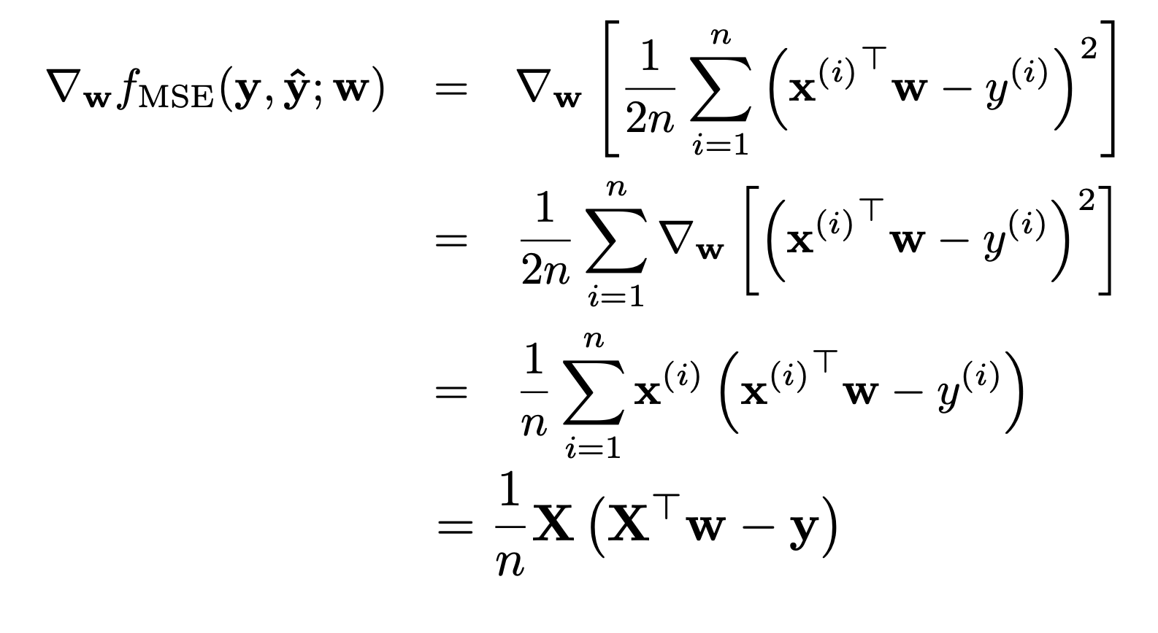
Gradient Descent
MSE case
10

Slide 68
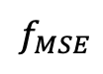
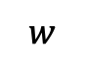
Gradient Descent
Gradient descent is a hill-climbing algorithm that
makes incremental changes to weight vector w
depending on the value of slope (i.e., gradient)
$$f_{MSE}$$
f
$$w$$
10

Slide 69
Gradient Descent
Gradient descent is a hill-climbing algorithm that
makes incremental changes to weight vector w
depending on the value of slope (i.e., gradient)
$$f_{MSE}$$
f
$$w$$
10

Slide 70
Gradient Descent
Gradient descent is a hill-climbing algorithm that
makes incremental changes to weight vector w
depending on the value of slope (i.e., gradient)
$$f_{MSE}$$
f
$$w$$
10

Slide 71
Gradient Descent. Algorithm
Randomly initialize weights w. This is our initial
weight vector w⁽⁰⁾
10

Slide 72

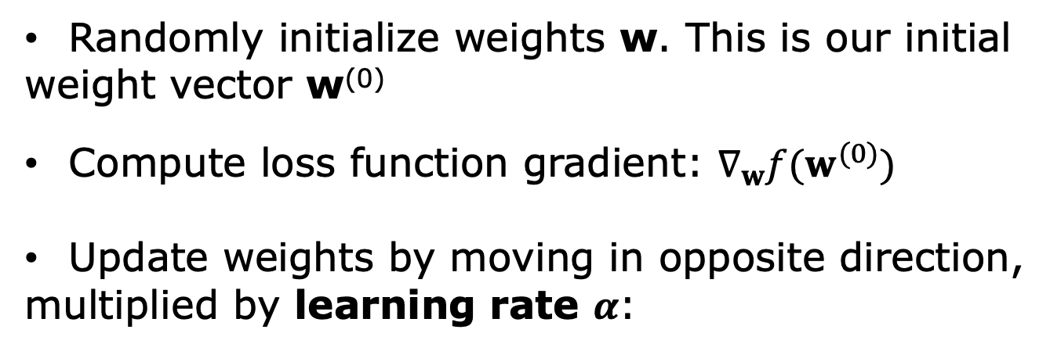
Gradient Descent. Algorithm
Randomly initialize weights w. This is our initial
weight vector w⁽⁰⁾
Compute loss function gradient: $∇_{w}f(w^{(0)})$
Update weights by moving in opposite direction,
multiplied by learning rate $α$:
$$w^{(1)}←w^{(0)}−α∇_{w}f(w^{(0)})$$
10

Slide 73
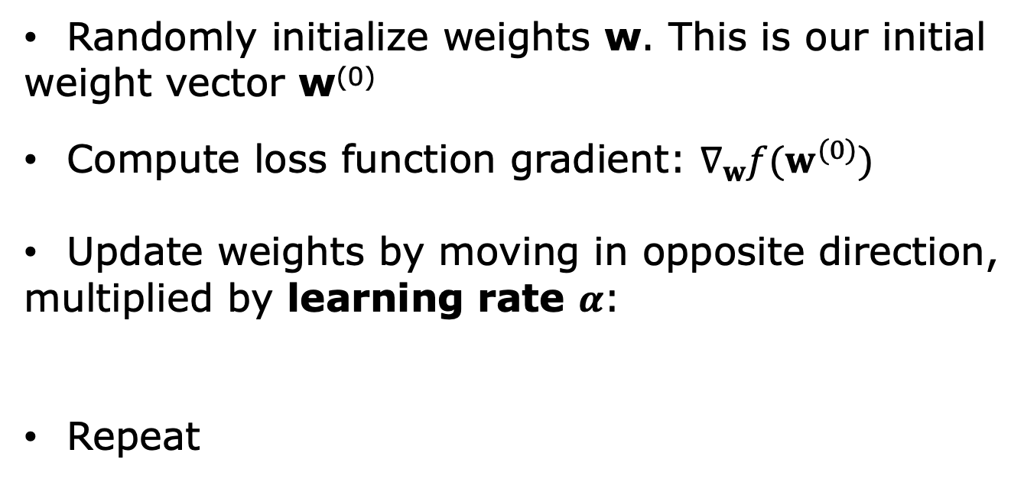
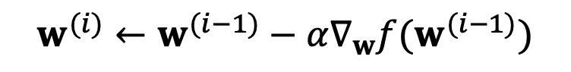
Gradient Descent. Algorithm
Randomly initialize weights w. This is our initial
weight vector w⁽⁰⁾
Compute loss function gradient: $∇_{w}f(w^{(0)})$
Update weights by moving in opposite direction,
multiplied by learning rate $α$:
Repeat
$$w^{(1)}←w^{(0)}−α∇_{w}f(w^{(0)})$$
$$w^{(i)}←w^{(i−1)}−α∇_{w}f(w^{(i−1)})$$
10

Slide 74
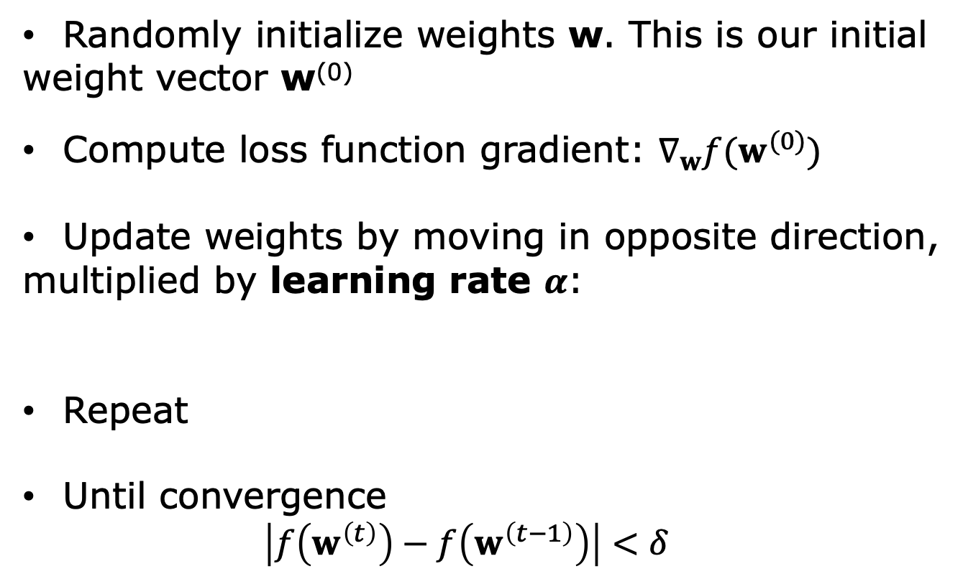
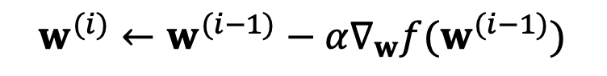
Gradient Descent. Algorithm
Randomly initialize weights w. This is our initial
weight vector w⁽⁰⁾
Compute loss function gradient: $∇_{w}f(w^{(0)})$
Update weights by moving in opposite direction,
multiplied by learning rate $α$:
Repeat
Until convergence
$$\left|f\left(w^{\left(t\right)}\right)−f\left(w^{\left(t−1\right)}\right)\right|<δ$$
$$w^{(1)}←w^{(0)}−α∇_{w}f(w^{(0)})$$
$$w^{(i)}←w^{(i−1)}−α∇_{w}f(w^{(i−1)})$$
10

